Slide 1
Laser Cut Narrative

Slide 2
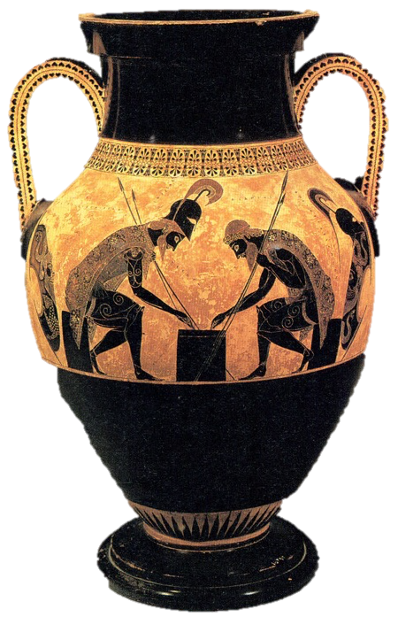
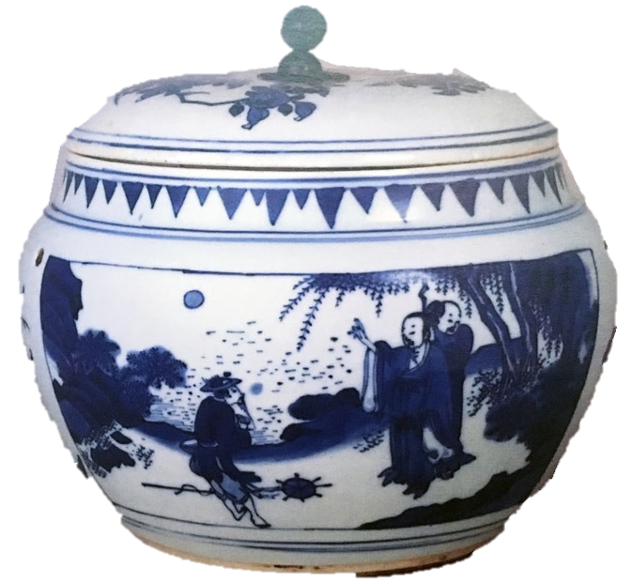
Narrative in History
Achilles & Ajax Exekias
Late Ming Dynasty

Slide 3
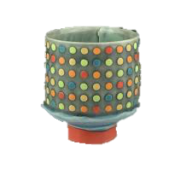
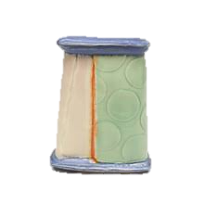
Chris Pickett

Slide 4
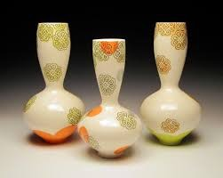
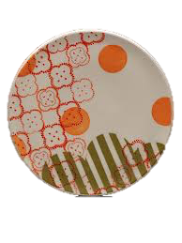
Meredith Host

Slide 5
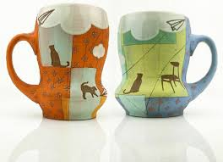
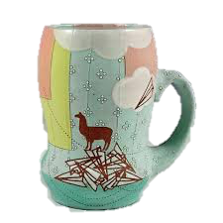
Renee LoPresti

Slide 6
What Can I Laser Cut?
Wood
Paper
Cardboard
Foam
Plastic
Leather
Rubber
For this project you will have to option to make paper stencils from BFK or Cardstock.

Slide 7
Laser Cutting
https://www.youtube.com/watch?v=hExZsMDKyXY

Slide 8
Process: Meredith Host
https://www.youtube.com/watch?v=RL3IYYx5ol4

Slide 9
Screen cast
https://www.youtube.com/watch?v=QYDQHKj2fc4

