Slide 1
PHOTO GIFS
Sarah Carlile and Vy Mai

Slide 2
FANTASY vs REALITY
What is “fantasy”?
What is “reality”?

Slide 3
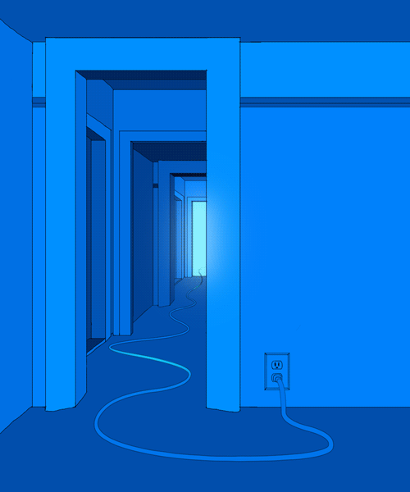
Carl Burton

Slide 4
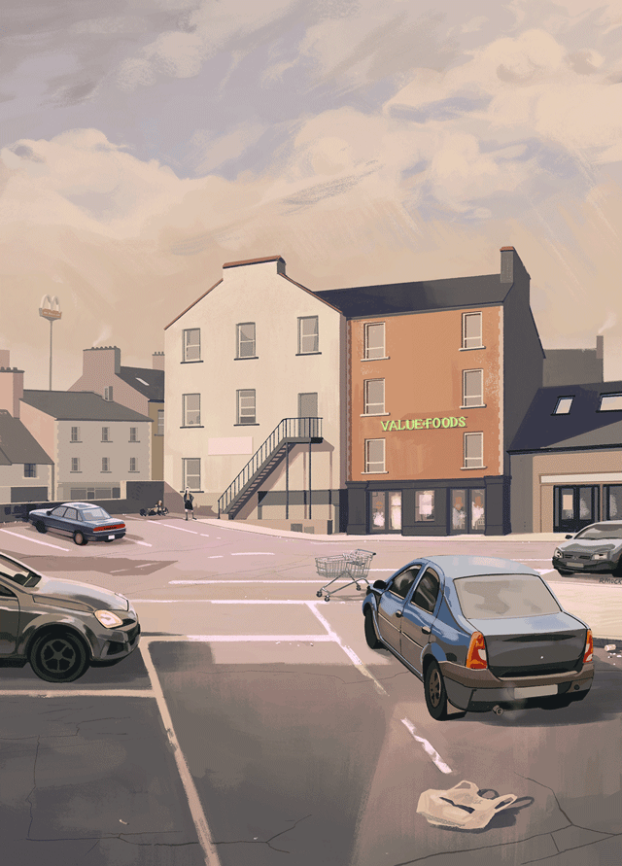
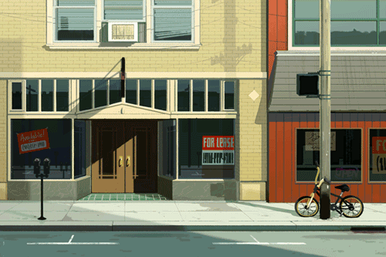
Rebecca Mock
Notes:
Use landscape/scenery/touristy pictures to create the GIF

Slide 5
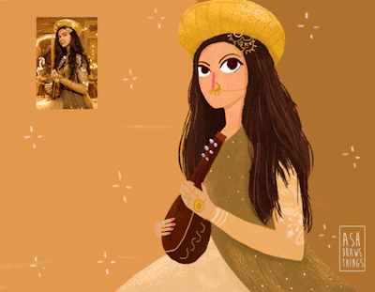
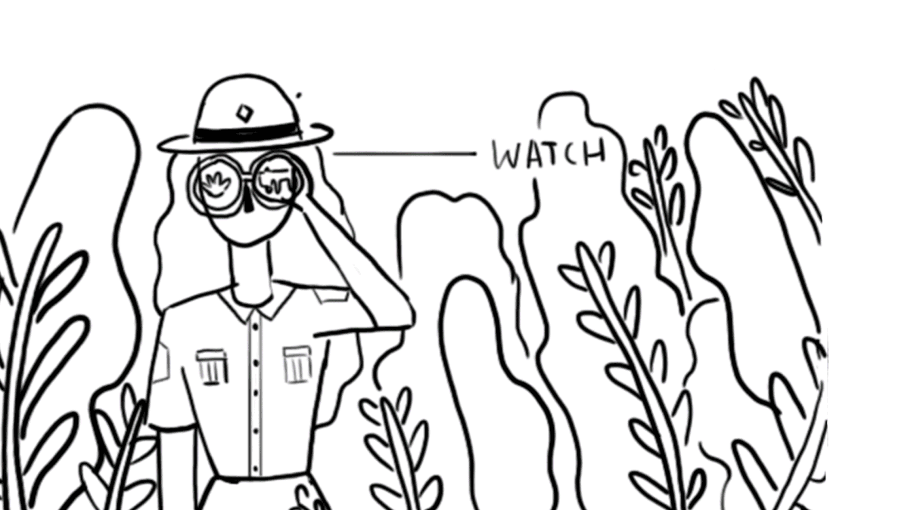
Aishwarya Sadasivan
Notes:
Use landscape/scenery/touristy pictures to create the GIF

Slide 6
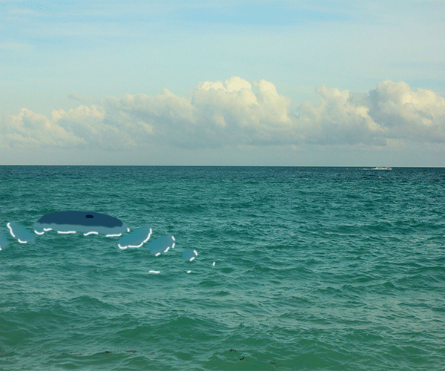
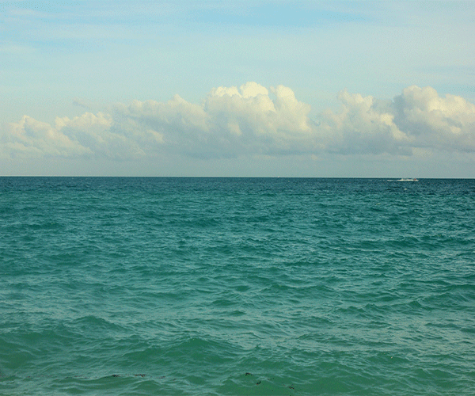
Example
Notes:
Use landscape/scenery/touristy pictures to create the GIF

Slide 7
Example
Notes:
Use landscape/scenery/touristy pictures to create the GIF

Slide 8
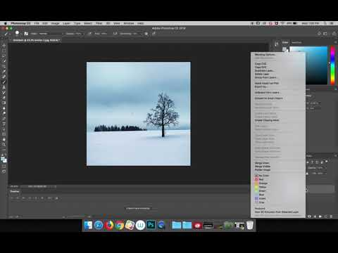
Screencast 1: Interaction GIF
https://www.youtube.com/watch?v=khpXH5xvAUk&t=31s

Slide 9
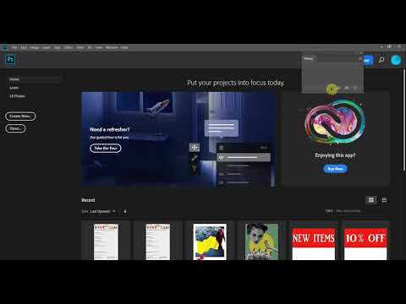
Screencast 2: Traced Image GIF
https://www.youtube.com/watch?v=C785mfq1E4o&list=PL89GxxPnCnq2ER_bji_cYv2dVUi9vF5GX

Slide 10
Day 1 Assignment
Students will follow along to create a
Basic GIF
Interaction GIF
Traced Image GIF

Slide 11
HOMEWORK
Step 02
Step 04
Look over Assignment 2
Brainstorm ideas for the content of your GIF + check the artist list for inspiration
Step 01
Step 03
Step 05
Watch the screencasts provided in the PowerPoint for a refresher
Choose which type(s) of GIF(s) you will create for day 2
Have at least 2 images ready for next class

Slide 12
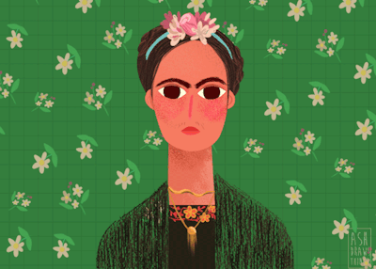
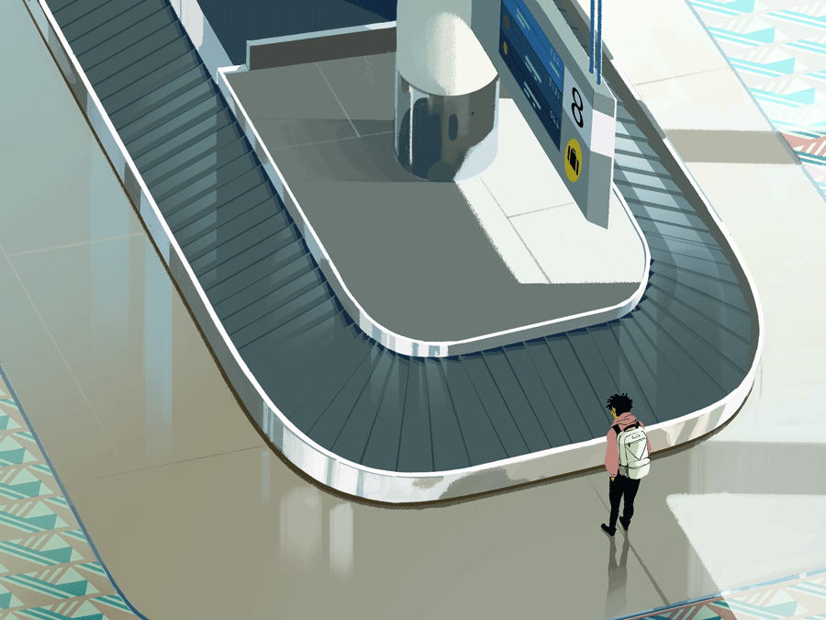
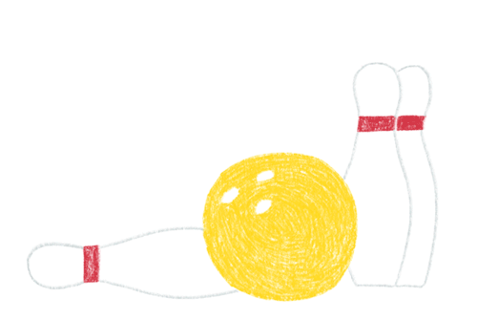
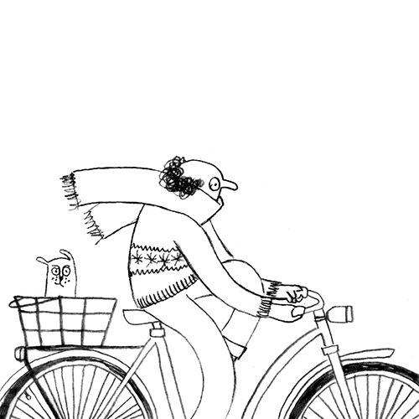
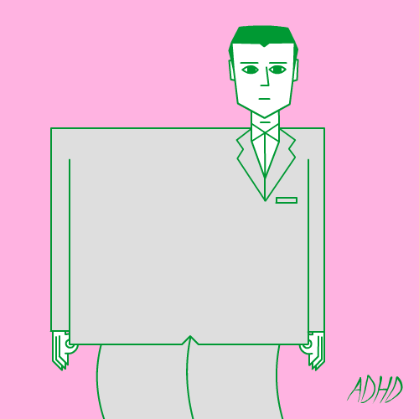
Inspiration
Carl Burton
Aishwarya Sadasivan
Click the GIF to visit the artist’s page
Carl Burton
Carl Burton
Rebecca Mock
Ricky Leung
Karo Rigaud
Jeremy Sengly
Carl Burton

Slide 13
Day 2 Assignment
Students will create one to two GIFs using either or both of the advanced techniques learned from the previous lesson.
If it is a pair of GIFs, then one should explore the idea of fantasy while the other explores reality.

Slide 14
THANKS!

